Slide 1

Modern App Deep Dive
Anthony Handley
UX Practice Lead
Brent Edwards
Principal Lead Consultant
Allen Conway
Senior Consultant
Level: Intermediate

Slide 2
MyVote
A Modern App
Notes:
[DEMO]
MyVote is a multi-platform voting app.
You can create a poll, take a poll, and see the results of polls.
Polls can have images and they are stored in Azure Blob Storage.
When a user signs up, they fill out some basic info. This allows us to do some demographic data mining.

Slide 3
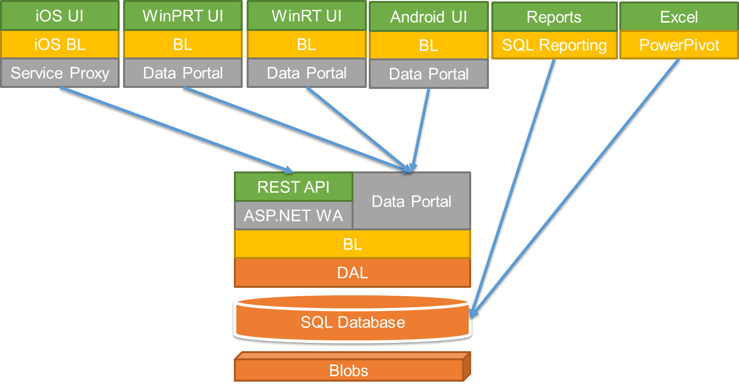
MyVote Architecture
Notes:
This is the MyVote architecture as it stands today.
We’re going to look at how we got to this point.

Slide 4
MyVote Client Platforms
Windows 8.1
Windows Phone 8.1
iOS
Android
Web
Notes:
Windows 8.1 and Windows Phone – me
iPad – Lou Miranda
Android – Xamarin – Nick Landry
Web – Aidan Ryan

Slide 5
MyVote Server Technologies
ASP.NET MVC 4
Azure
SQL Server
CSLA
Notes:
ASP.NET MVC4 drives the REST API and the Web client.
CSLA is the business object framework we use for the business logic.
Azure for web hosting as well as blob storage
SQL Server 2012 for the database

Slide 6
The code
[DEMO]

Slide 7
Questions?

